Slide 1
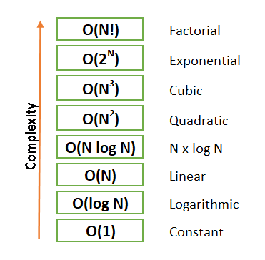
BIG-O

Slide 2
Class activity 2
By calculating the number of the primitive operations for each of the following code segments
https://www.cpp.edu/~ftang/courses/CS240/lectures/analysis.htm#:~:text=Primitive%20operations%20are%20basic%20computations,independent%20from%20the%20programming%20language.
Primitive operations are basic computations performed by an algorithm.
Examples are
evaluating an expression,
assigning a value to a variable,
indexing into an array,
calling a method,
returning from a method,
etc.
They are easily identifiable in pseudocode and largely independent from the programming language.

Slide 3
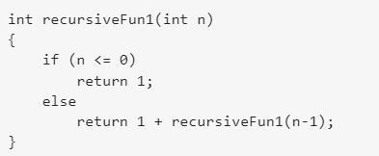
Recursion
This function is being called recursively n times before reaching the base case so its O(n), often called linear.
T(0) = c
T(n) = c + T(n-1)
T(n) = c + c + T(n-2)
.
.
.
T(n) = k*c + T(n-k)
n = K
T(n) = n*c +T(0) = n*c + c

Slide 4
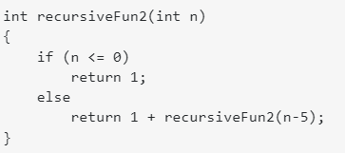
This function is called n-5 for each time, so we deduct five from n before calling the function, Actually called order of n/5 times. And, O(n/5) = O(n) .
T(0) = c
T(n) = c + T(n-5)
T(n) = c + c + T(n-10)
.
.
.
T(n) = k*c + T(n-5k)
n = 5K
T(n) = (n/5)*c +T(0) = (n/5)*c + c

Slide 5
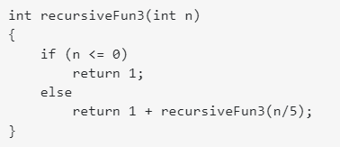
This function is log(n) base 5, for every time we divide by 5 before calling the function so its O(log(n))(base 5), often called logarithmic and most often Big O notation and complexity analysis uses base 2.

Slide 6
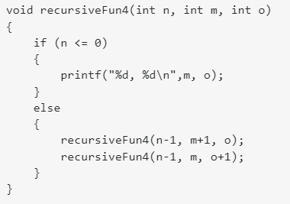
Here, it's O(2^n), or exponential, since each function call calls itself twice unless it has been recursed n times.

Slide 7
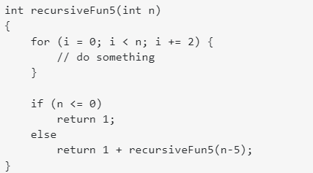
Here the for loop takes n/2 since we're increasing by 2, and the recursion takes n/5 and since the for loop is called recursively, therefore, the time complexity is in
(n/5) * (n/2) = n^2/10,
due to Asymptotic behavior and worst-case scenario considerations or the upper bound that big O is striving for, we are only interested in the largest term so O(n^2)
Base Case: T(0) = 1, leading to T(n) = n/2 + T(n-5) which when expanded leads to T(n) = n/2 + (n/2 + T(n-10) expanded further leads to T(n) = n/2 + (n/2 + (n/2 + T(n-15) which can be described as T(n) = k(n/2) + T(n-5k) so we then find T(0) by 5k = n and substitute k in appropriately T(n) = (n/5)(n/2) + T(n - n) which reduces to T(n) = (n^2/10) + T(0) which reduces to T(n) = (n^2/10) + 1 which is T(n) = n^2

